Slide 1
Digital Communication 24EC2208
AY 2025-26
Spread Spectrum

Slide 2
Code Division Multiple Axis System (CDMA)

Slide 3
Code Division Multiple Access (CDMA)
Multiplexing Technique used with spread spectrum
Start with data signal rate D called bit data rate
Break each bit into k chips according to fixed pattern specific to each user. User’s code
New channel has chip data rate kD chips per second
Example: k = 6, three users (A,B,C) communicating with base receiver R
Code for A = < 1, -1, -1, 1, -1, 1 >
Code for B = < 1, 1, -1, -1, 1, 1 >
Code for C = < 1, 1, -1, 1, 1, -1 >

Slide 4
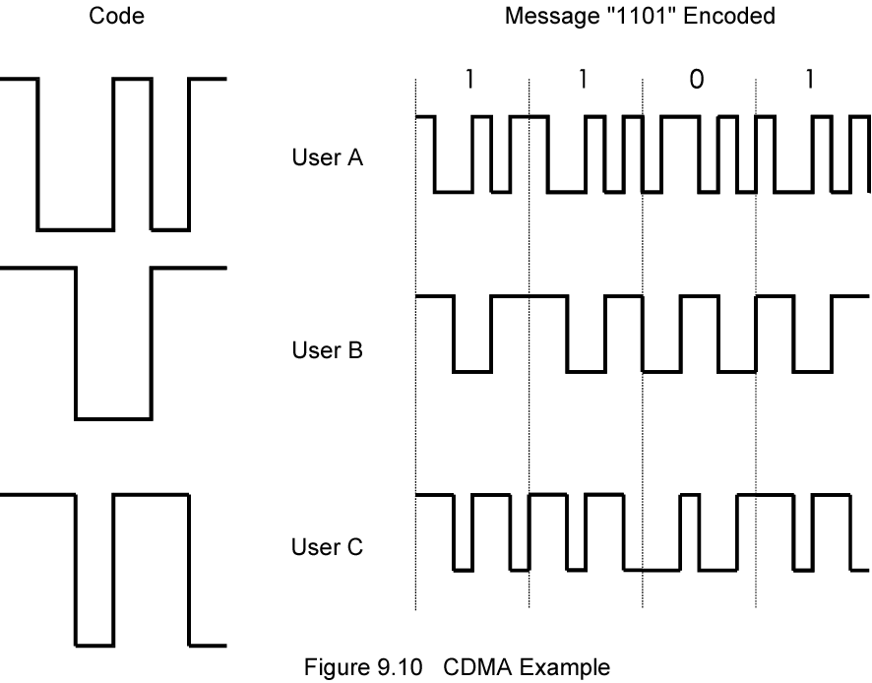
CDMA Example

Slide 5
CDMA Explanation
Consider A communicating with base
Base knows A’s code
Assume communication already synchronized
A wants to send a 1
Send chip pattern <1,-1,-1,1,-1,1>
A’s code
A wants to send 0
Send chip[ pattern <-1,1,1,-1,1,-1>
Complement of A’s code
Decoder ignores other sources when using A’s code to decode
Orthogonal codes

Slide 6
CDMA for DSSS
n users each using different orthogonal PN sequence
Modulate each users data stream
Using BPSK
Multiply by spreading code of user

Slide 7
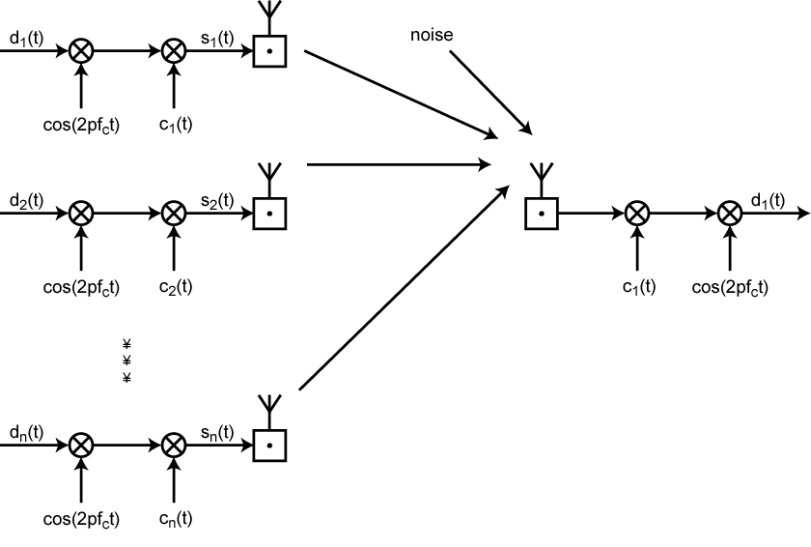
CDMA in a DSSS Environment
BPSK
BPSK
BPSK

Slide 8
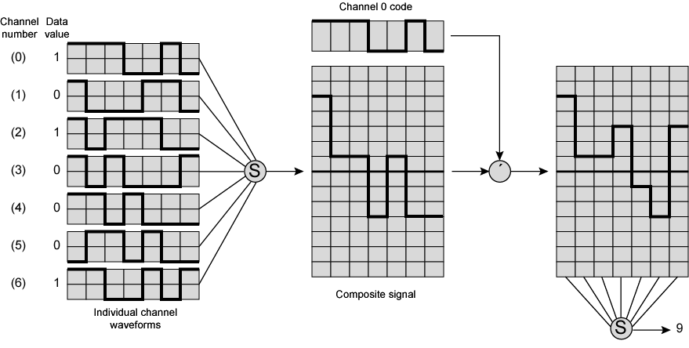
Seven Channel CDMA Encoding and Decoding

Slide 9
End

